Slide 2
The Role of Strategy and Planning
Strategy is about making the right choices – to win we must choose to do some things and not others.
Strategy is about increasing the likelihood of success – but it does not guarantee it.
In developing strategy and implementing plans in a VUCA world we must be agile and quickly respond to shifts in the market as we experiment and test what will succeed.
IABC has one strategy, but many plans. To be successful we must have strategic alignment among the efforts across our network - International, Regions and Chapters.
This Planning Toolkit has been designed to support IABC Volunteer Leaders in their planning processes for:
International Committees & Taskforces
Regions
Chapters
Projects and programs that are developed and executed at all levels
Members of the IEB and HQ executive staff are available to support our Volunteer Leaders in their planning process.

Slide 3
Table of Contents
The CASE Framework
Cascade of Choices Methodology

Slide 4
CASE Framework
Current State
Aspiration
Strategy
Execution
How to create your CASE for change?
The CASE Framework is a simple way to kick off your planning with a strategic conversation.
A four-step approach that helps a facilitator guide any group through complex situations by:
building clarity and alignment
envisioning potential futures
shaping and making choices
activating execution

Slide 5
What Matters most?
Current State
Aspiration
Strategy
Execution
Step by step…
Current state sets the scene and frames a clear comprehensive picture of systemic issues and impacts.
Includes:
History behind the issue
External dynamics/drivers
Internal influences
Operational impacts
Concerns of individual communities
Questions to ask
What are the internal/external factors impacting the situation?
Who are the stakeholders?
What are the motivations?
What narratives shape the issue?
What’s the source of the issue?
Pitfalls
Too big a sandpit
No clearly defined problem/symptom
Unfounded insights
Too much focus on irrelevant issues
Too much negativity

Slide 6
What Matters most?
Current State
Aspiration
Strategy
Execution
Step by step…
The Aspiration establishes the vision and ideally the noble purpose.
This is often the most difficult part of the process given the creative tensions that can arise but a successful outcome relies on a clear, inspired intent.
A good Aspiration is compelling, genuine, and meaningful.
Questions to ask
What might be possible?
What metaphors might resonate?
What criteria defines a good outcome?
Is it authentic?
Is it ambiguous?
Is it energizing?
Is it value-led?
Pitfalls
Settling for what’s probable
Platitudes
Generalities
Wordsmithing
Too big and fluffy
Too commonplace
Not bold enough

Slide 7
What Matters most?
Current State
Aspiration
Strategy
Execution
Step by step…
The Strategy identifies the choices that need to be targeted/leveraged to achieve the Aspiration. Be sure to think through: what must be true for us to achieve Aspiration.
Questions to ask
What must we do?
What should we do?
What capabilities will be needed?
What needs to be invented?
Technologies required?
Are stakeholders advocates or detractors?
What are the risks?
How will risks be mitigated?
Pitfalls
Choices are too intangible, too incremental
Being derailed by too many details
Being side tracked by personal agendas
Ignoring stakeholders
Bypassing potential roadblocks

Slide 8
What Matters most?
Current State
Aspiration
Strategy
Execution
Step by step…
The Execution identifies all the discrete activities (planning, scheduling, resourcing, etc.) that need to be achieved.
It also identifies the those accountable to drive implementation with clear tasks, methods, and milestones.
Questions to ask
What specific things need to be done?
What are the priorities to ensure traction?
What will be measured?
What are the metrics for success?
What is the agreed timetable?
What risk do we have to avoid?
How will things be communicated/managed?
Has everything been considered?
Pitfalls
Lack of clarity and commitment
Unrealistic expectations
Non-actionable items
Over the top planning
Too much time spent on irrelevant details

Slide 9
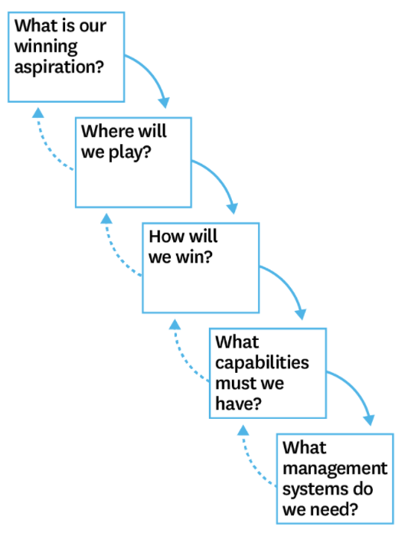
Cascade of Choices
Playing to win: How Strategy Really Works is a leading strategy planning book by AG Lafley and Roger L Martin.
Its premise is that strategy is not complex, but it is hard. It’s hard because it forces people and organizations to make specific choices.
At its heart is a simple framework ‘The Cascade of Choices’.
This is a useful tool for Volunteer Leaders to use in developing their implementation plan for Stronger Together: IABC2025

